Slide 1
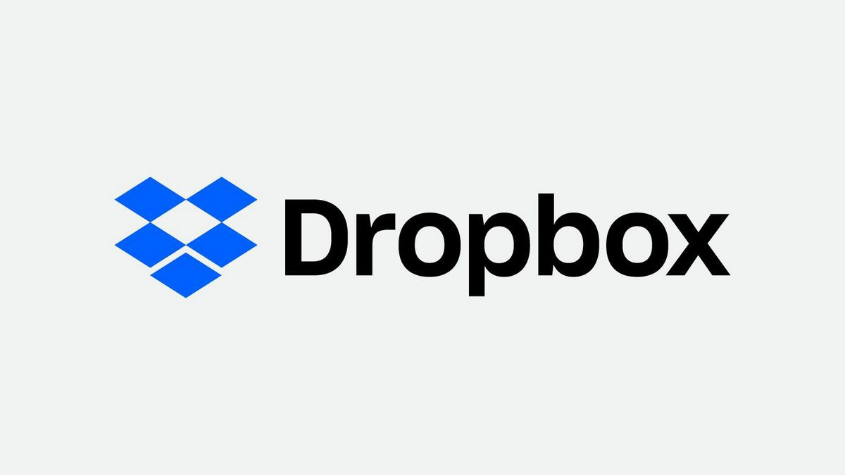
BI analysis : 5 tools
Dublin, Ireland

Slide 2
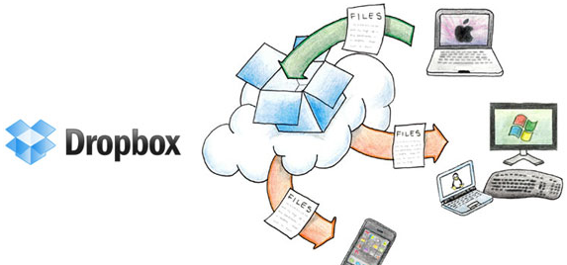
What is Dropbox?
Founded in 2007 by Drew Houston
Headquarters in San Francisco
Dropbox ecosystem

Slide 3
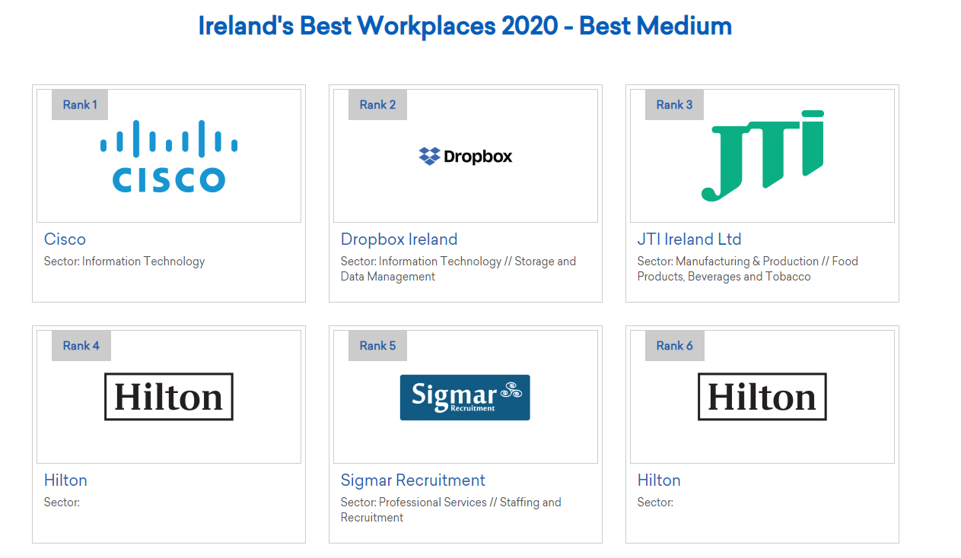
Dropbox - Dublin
First office outside US
Opened in December 2012
Best Workspace prize

Slide 4
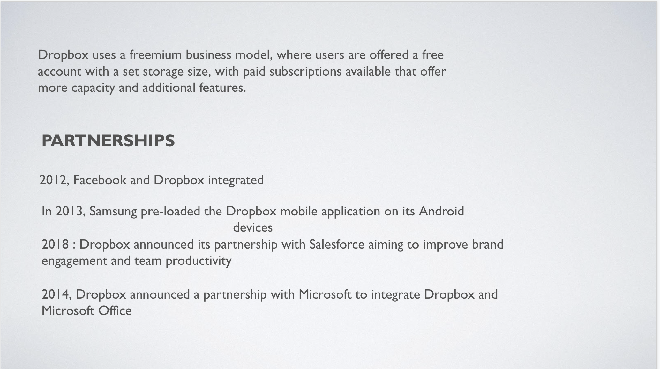

Slide 5
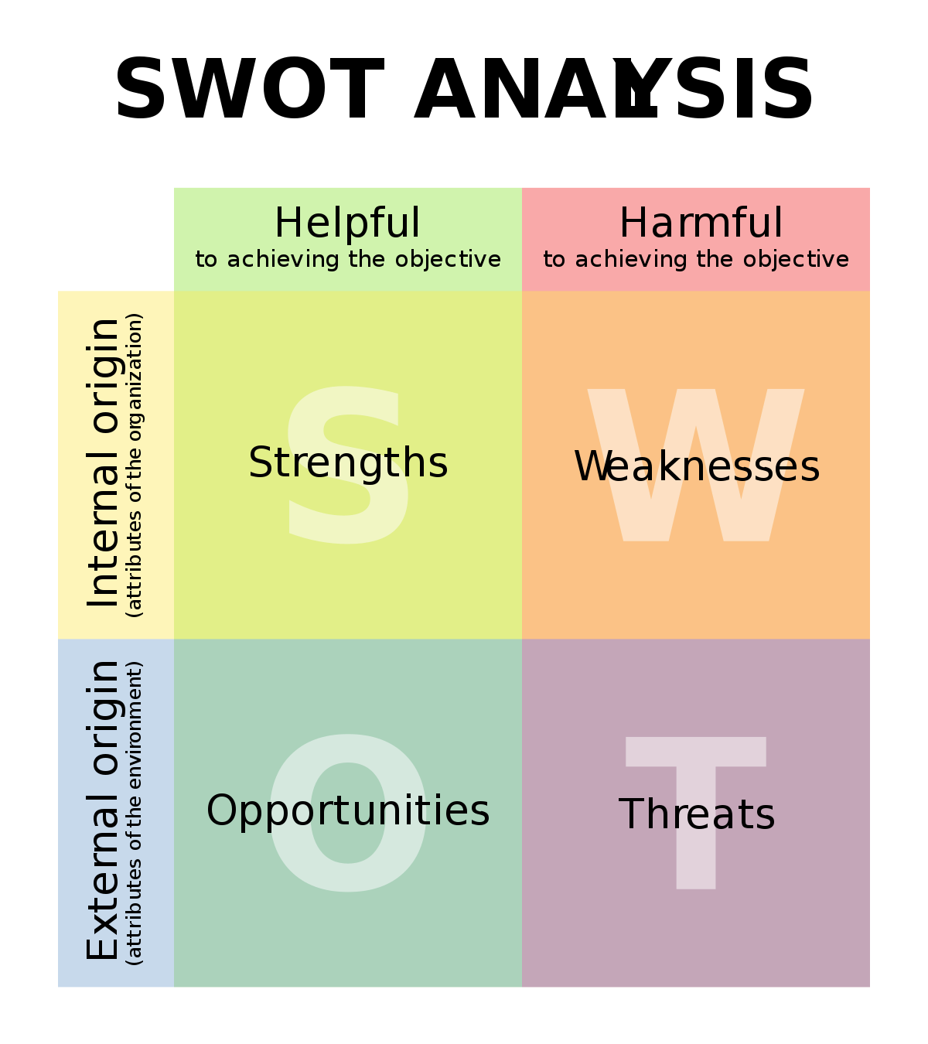
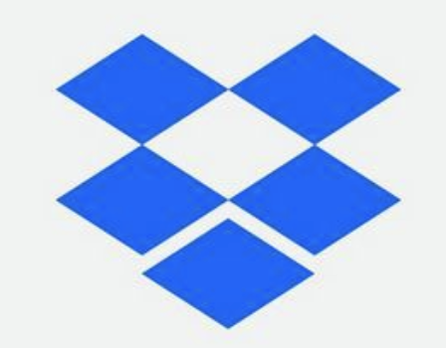
Micro-environmental factors
SWOT
ANALYSIS

Slide 6
S
T
R
E
N
T
H
S
W
E
E
K
N
E
S
S
High user base : more than 300 million
Highly based on corporate clients
Innovative : replacement of USB drive
Small space in free version (google drive)
Multiple language | Multiple platforms
Security of data
Strong financials

Slide 7
O
P
P
O
R
T
U
N
I
T
Y
T
H
R
E
A
T
S
Rapid technological dev.
Google drive / one drive etc
Need for way to file transfer
Change in gov. regulations
Growing need for data storage
Security and privacy issues
Internet penetration and mobile phone users

Slide 8
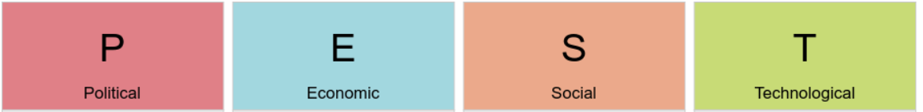
ANALYSIS
Macro-environmental factors

Slide 9
Ireland shares borders with UK, trade was easy.
Brexit (Decision of the UK to come out of the EU) may complicate the free movement of goods and people between Ireland and the UK.
Corruption is not major concern , although companies face bribery risks at local administrative levels.
Ireland’s low corporate tax rates and a talented workforce.
Irish economy was amongst the first in the EU to recover from the 2008 recession.
Irish economy heavily relies on exports of machinery and equipment, computers, chemicals, medical devices,
Dublin, the capital of Ireland, is the one of the most cosmopolitan cities in Europe.
Ireland is faced with some massive social challenges. 780,000 people live in poverty, though the country is one of the richest in the world.
The cost of living in Dublin is pretty much the same as that in London.
Technologically advanced,its ICT industry contributes immensely to the GDP.
High quality, and multi-lingual tech talents are available in the country.
Demand >> available talent.
The country’s failure to connect more than half a million homes and businesses to broadband

Slide 10
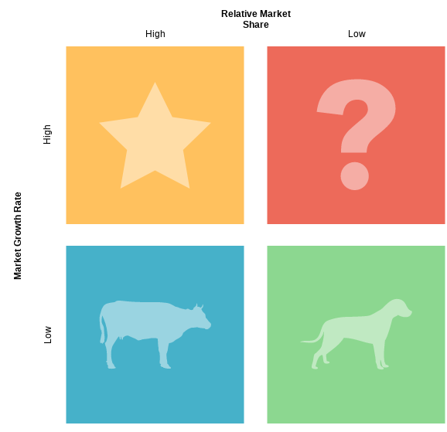
BCG matrix
File hosting service

Slide 11
Balanced Scorecard
Attract more users and encourage free users to switch to paying users
Popularity
User experience
Cooperation with slack
financial
customer
strategy
Internal process
Learning
and growth
Store data security
Use fluency
Development of new operating modes under the background of remote office

Slide 12
Ansoff Matrix
 | products
markets |  | existing | new
 | existing | User file cloud storage service | Intelligent management of user files and work notifications
 | new | Responding to remote work requirements under the global epidemic，Dropbox paper | Dropbox smart business

Slide 13
Porter’s 5 forces
Many options in storage industry
Low capital required to enter
Low
Large competition ex : google drive
In house storage/ not using cloud
New Entries
Competitors + Rivalry
Suppliers
Choices ie google drive, one drive, carbonite etc
High power
Brand loyalty
Use to attract to become a lifetime customer
Substitutes
Buyers

